Slide 1
Physics Laboratory 2 – Experiment 10: Black body radiation
Lukas Prader¹,Andrija Đokić², Kemal Önen³
Advisor: Dr. Fabio Zappa
Date of experimental execution: 15.06.2023
Date of presentation: xx.06.2023
¹ lukas.prader@student.uibk.ac.at
² andrija.djokic@student.uibk.ac.at
³ kemal.oenen@student.uibk.ac.at

Slide 2
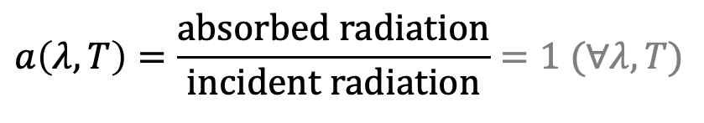
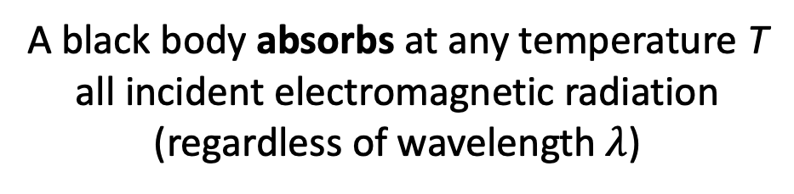
What is a black body?
A black body absorbs at any temperature T all incident electromagnetic radiation (regardless of wavelength $λ$)
$$a\left(λ,T\right)=\frac{absorbed radiation}{incident radiation}=1 (∀λ,T)$$
Although idealized model, experimental setups do exist (black surfaces, cavity with a hole…)
[1]: Univ.-Prof. Dr. Gregor Weihs et. al., “Physics Laboratory 2, Experiment 10: Black body radiation.” Laboratory course manual, Summer semester 2023.

Slide 3
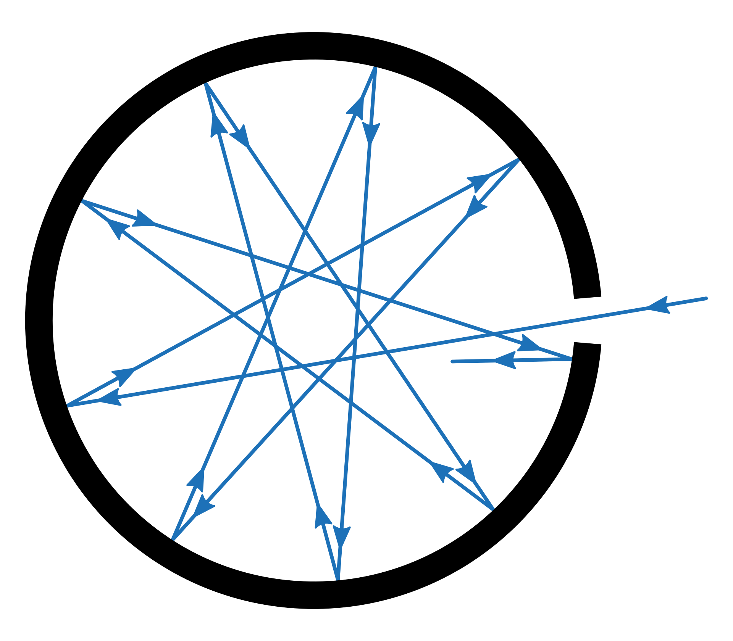
What is a black body?
one possible realization:
A black body absorbs at any temperature T all incident electromagnetic radiation (regardless of wavelength $λ$)
$$a\left(λ,T\right)=\frac{absorbed radiation}{incident radiation}=1 (∀λ,T)$$
Due to multiple reflections inside the cavity, radiation can be fully adsorbed
The body in a state of heat equilibrium emits radiation. The intensity distribution is only determined by it‘s temperature.
Source: https://en.wikipedia.org/wiki/Black_body#CITEREFPlanck1914
[1]: Univ.-Prof. Dr. Gregor Weihs et. al., “Physics Laboratory 2, Experiment 10: Black body radiation.” Laboratory course manual, Summer semester 2023.

Slide 4
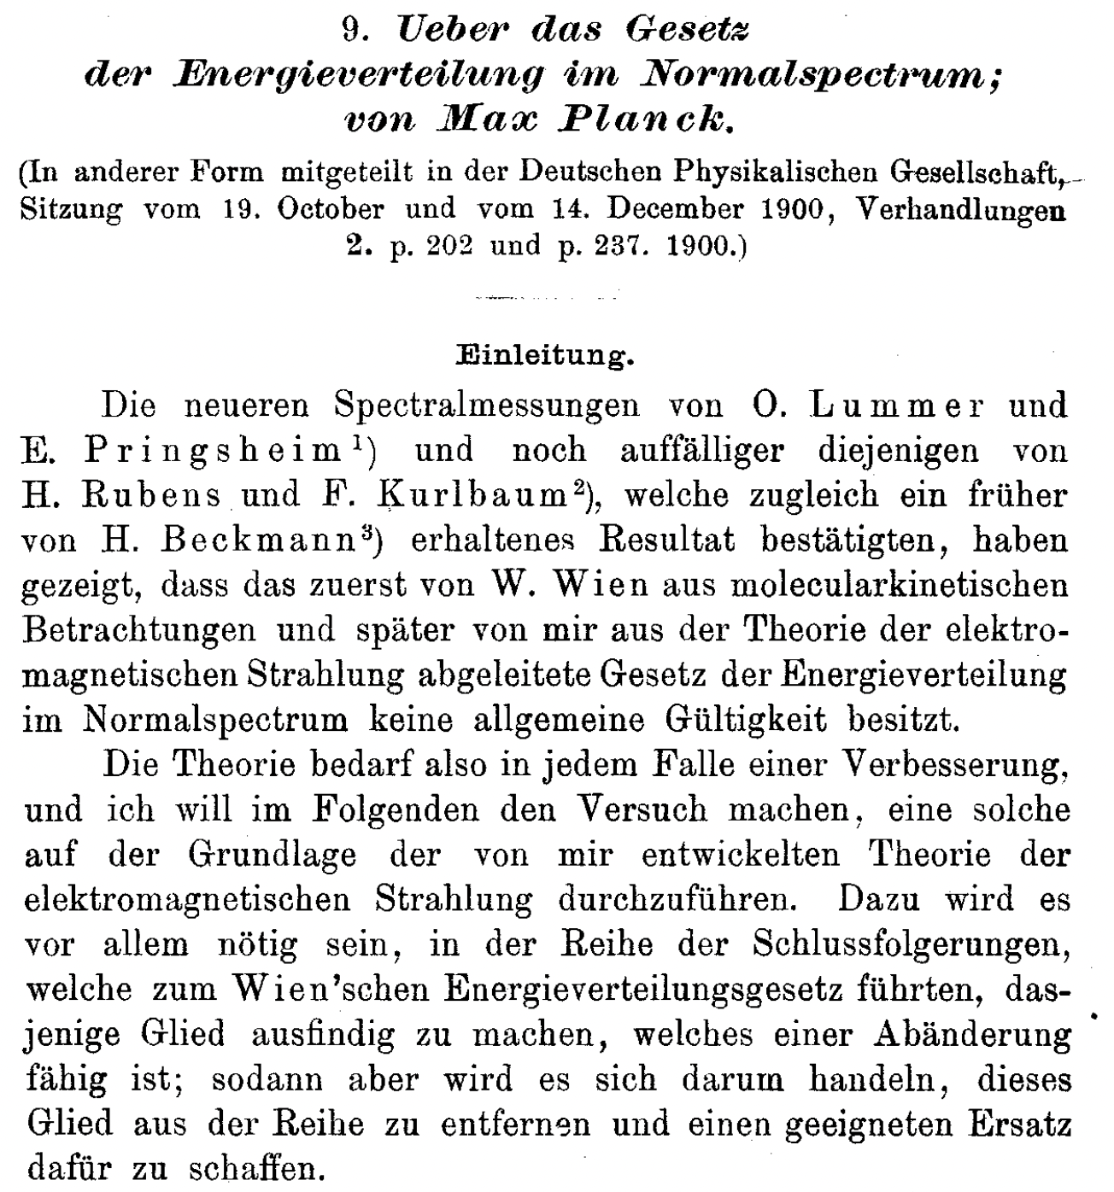
Historical background
From the website of the Max-Planck society [3]:
“Although the world is full of light-emitting bodies, for a long time we knew very little about the physical laws of the creation of light. Why does a piece of wire turn red at a certain temperature and white at another? Gustav Kirchhoff discovered in the mid-19th century that the general problem of radiation could be reduced to the study of black-body radiation. However, there were major experimental and theoretical obstacles to overcome, which represented an enormous challenge for contemporary physics.“
Planck aimed to derive Wien‘s law from the basis of the thermodynamics of electromagnetic radiation (1899)
As Wien‘s law was experimentally disproven, Planck turned to Boltzmann‘s probability theory (19th October 1900)
➔ The energy elements (= quanta) of radiation used in the derivation, led to a revolution in the then-established physics
[2]: Planck, M. (1901), „Ueber das Gesetz der Energieverteilung im Normalspectrum“. Ann. Phys., 309: 553-563. https://doi.org/10.1002/andp.19013090310
[3]: Online-article: “Energy in packets – What did Planck discover?“. https://www.mpg.de/19252749/what-did-max-planck-discover

Slide 5
Theory

Slide 6
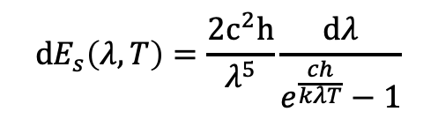
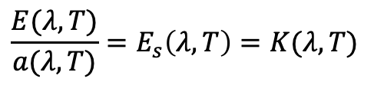


Theoretical descriptions of black body radiation
Kirchhoff's law of thermal radiation
Planck's law
$$\frac{E(λ,T)}{a(λ,T)}=E_{s}\left(λ,T\right)=K(λ,T)$$
$$dE_{s}\left(λ,T\right)=\frac{2c^{2}h}{λ^{5}}\frac{dλ}{e^{\frac{ch}{kλT}}−1}$$
$E(λ,T)$ describes the energy of thermal radiation per unit area, per unit time, for the wavelength $λ$ + d$λ$ and temperature T.
$E(λ,T)$ is dependent of surface properties and material!
BUT:
Kirchhoff function $K(λ,T)$ is only dependent of $λ$ and T.
As $a(λ,T)$ is always 1 for black bodies, they emit the most thermal radiation
For $a(λ,T)$ = 0 ➔ $E(λ,T)$ = 0
…spectral emissive power per unit area, per unit solid angle, per unit frequency for particular radiation frequencies $λ$ and temperature T.
[1]: Univ.-Prof. Dr. Gregor Weihs et. al., “Physics Laboratory 2, Experiment 10: Black body radiation.” Laboratory course manual, Summer semester 2023.

Slide 7
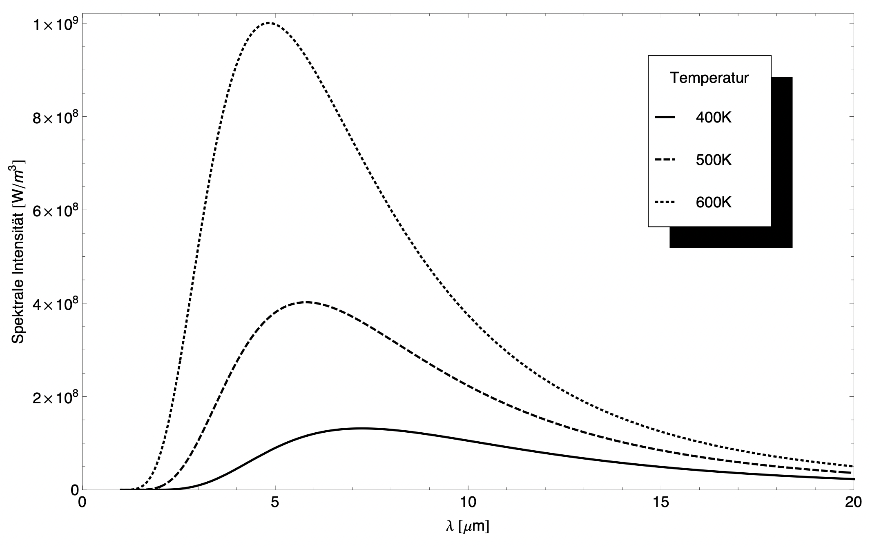

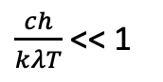
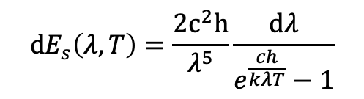
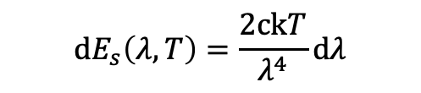
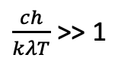

Theoretical descriptions of black body radiation
Planck's law
Wien's law
$\frac{ch}{kλT}$>> 1
$$dE_{s}\left(λ,T\right)=\frac{2c^{2}h}{λ^{5}}\frac{dλ}{e^{\frac{ch}{kλT}}−1}$$
$$dE_{s}\left(λ,T\right)=\frac{2c^{2}h}{λ^{5}}\frac{dλ}{e^{\frac{ch}{kλT}}}$$
…spectral emissive power per unit area, per unit solid angle, per unit frequency for particular radiation frequencies $λ$ and temperature T.
$\frac{ch}{kλT}$<< 1
Rayleigh-Jeans law
$$dE_{s}\left(λ,T\right)=\frac{2ckT}{λ^{4}}dλ$$
[1]: Univ.-Prof. Dr. Gregor Weihs et. al., “Physics Laboratory 2, Experiment 10: Black body radiation.” Laboratory course manual, Summer semester 2023.

Slide 8
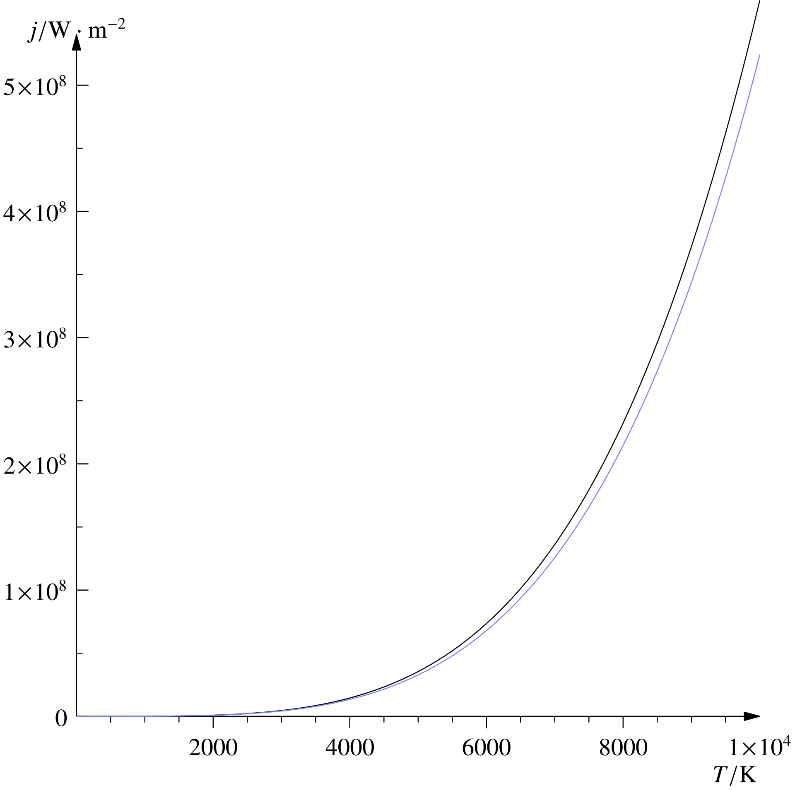
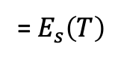
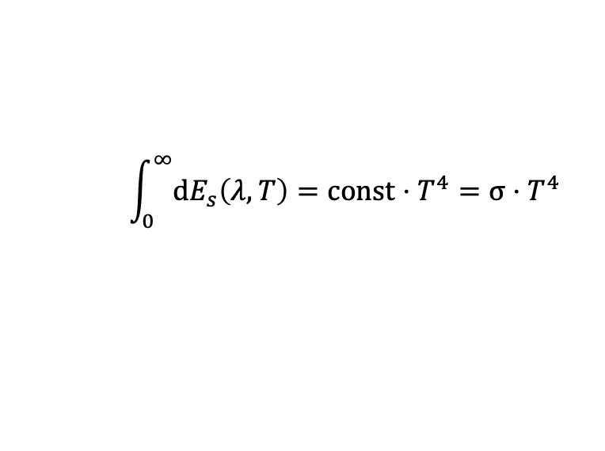
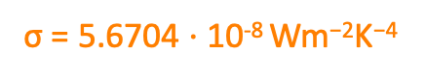
Theoretical descriptions of black body radiation
Stefan-Boltzmann law
The total energy of a black body radiator for constant temperature T can be calculated by integrating Planck‘s law over all frequencies:
$$\int_{0}^{∞}{{dE}_{s}\left(λ,T\right)}=const⋅T^{4}=σ⋅T^{4}$$
= $E_{s}\left(T\right)$
σ = 5.6704 $⋅$10⁻⁸ Wm⁻²K⁻⁴
Source: https://en.wikipedia.org/wiki/Stefan–Boltzmann_law
[1]: Univ.-Prof. Dr. Gregor Weihs et. al., “Physics Laboratory 2, Experiment 10: Black body radiation.” Laboratory course manual, Summer semester 2023.

Slide 9
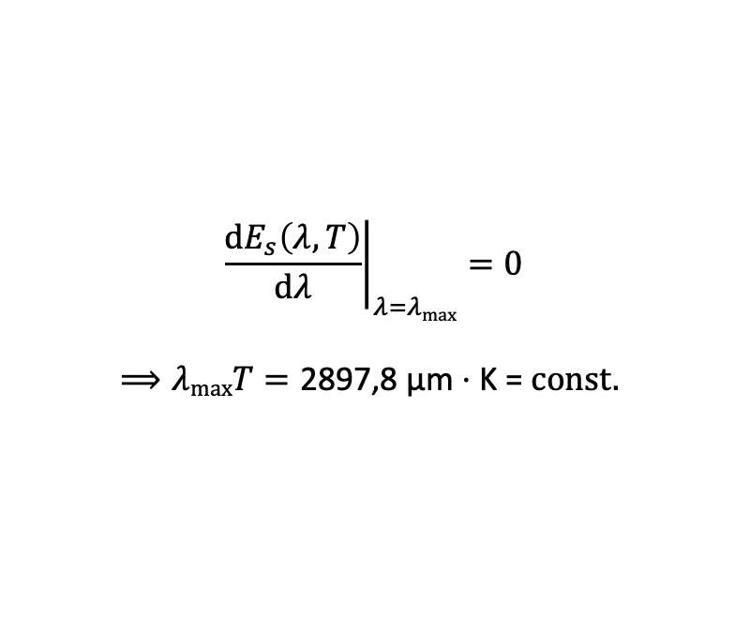
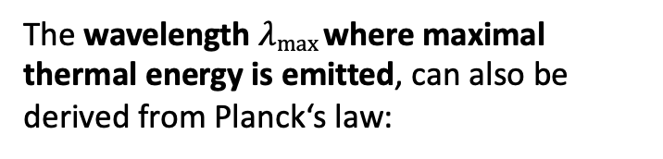
Theoretical descriptions of black body radiation
Stefan-Boltzmann law
Wien‘s displacement law
The total energy of a black body radiator for constant temperature T can be calculated by integrating Planck‘s law over all frequencies:
The wavelength $λmax$where maximal thermal energy is emitted, can also be derived from Planck‘s law:
$$\int_{0}^{∞}{{dE}_{s}\left(λ,T\right)}=const⋅T^{4}=σ⋅T^{4}$$
$${\left.\frac{{dE}_{s}\left(λ,T\right)}{dλ}\right|}_{λ=λmax}=0$$
$$⟹λmaxT=\text{2897,8 }\text{μ}\text{m}⋅\text{K}\text{ = }\text{const}\text{. }$$
= $E_{s}\left(T\right)$
σ = 5.6704 $⋅$10⁻⁸ Wm⁻²K⁻⁴
[1]: Univ.-Prof. Dr. Gregor Weihs et. al., “Physics Laboratory 2, Experiment 10: Black body radiation.” Laboratory course manual, Summer semester 2023.

Slide 10
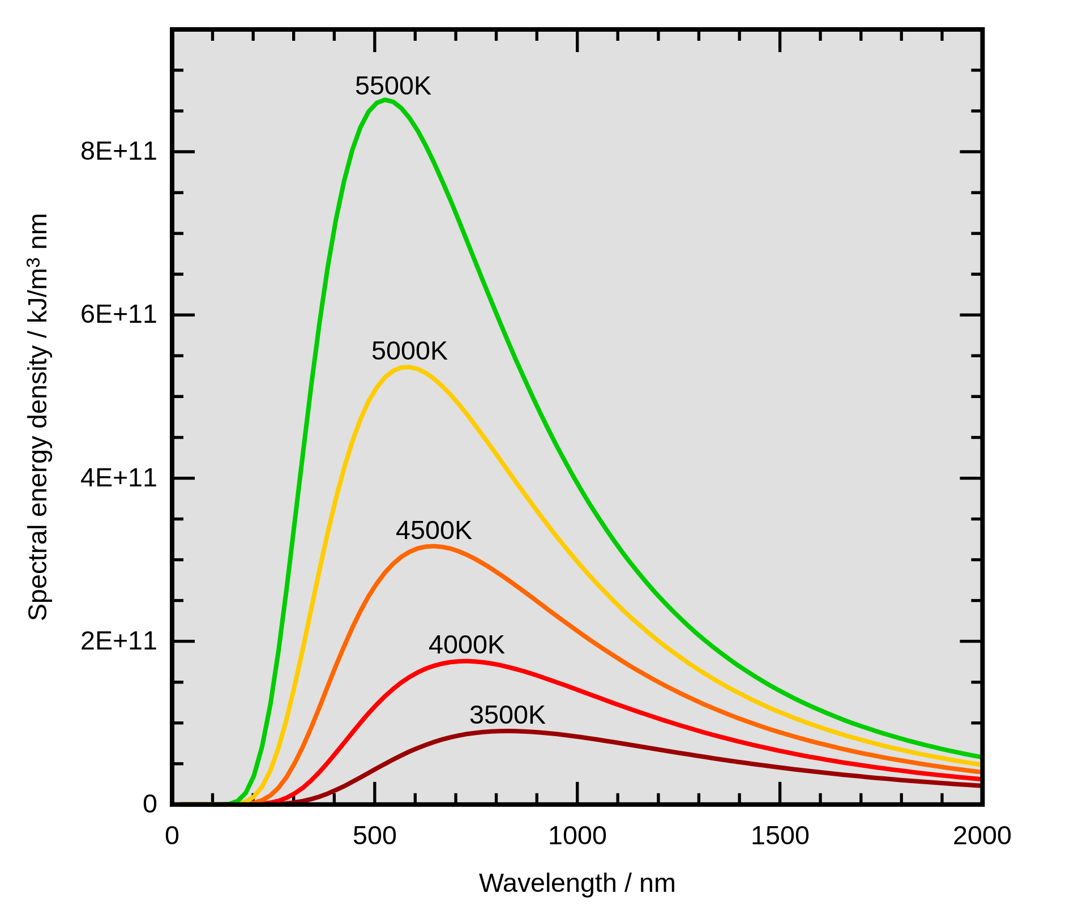
Theoretical descriptions of black body radiation
Wien‘s displacement law
The wavelength $λmax$where maximal thermal energy is emitted, can also be derived from Planck‘s law:
$${\left.\frac{{dE}_{s}\left(λ,T\right)}{dλ}\right|}_{λ=λmax}=0$$
$$⟹λmaxT=\text{2897,8 }\text{μ}\text{m}⋅\text{K}\text{ = }\text{const}\text{. }$$
Source: https://en.wikipedia.org/wiki/Wien%27s_displacement_law
[1]: Univ.-Prof. Dr. Gregor Weihs et. al., “Physics Laboratory 2, Experiment 10: Black body radiation.” Laboratory course manual, Summer semester 2023.

Slide 11


Theoretical descriptions of black body radiation
Stefan-Boltzmann law
Wien‘s displacement law
The total energy of a black body radiator for constant temperature T can be calculated by integrating Planck‘s law over all frequencies:
The wavelength $λmax$where maximal thermal energy is emitted, can also be derived from Planck‘s law:
$$\int_{0}^{∞}{{dE}_{s}\left(λ,T\right)}=const⋅T^{4}=σ⋅T^{4}$$
$${\left.\frac{{dE}_{s}\left(λ,T\right)}{dλ}\right|}_{λ=λmax}=0$$
$$⟹λmaxT=\text{2897,8 }\text{μ}\text{m}⋅\text{K}\text{ = }\text{const}\text{. }$$
= $E_{s}\left(T\right)$
σ = 5.6704 $⋅$10⁻⁸ Wm⁻²K⁻⁴
Lambert‘s cosine law
Under the assumption that radiation is emitted isotropic, the measured power at a detector is only dependent of their relative position, i.e. the angle $θ$ between detector and emitting surface:
$$J\left(θ\right)=J⋅cos⁡(θ)$$
[1]: Univ.-Prof. Dr. Gregor Weihs et. al., “Physics Laboratory 2, Experiment 10: Black body radiation.” Laboratory course manual, Summer semester 2023.

Slide 12
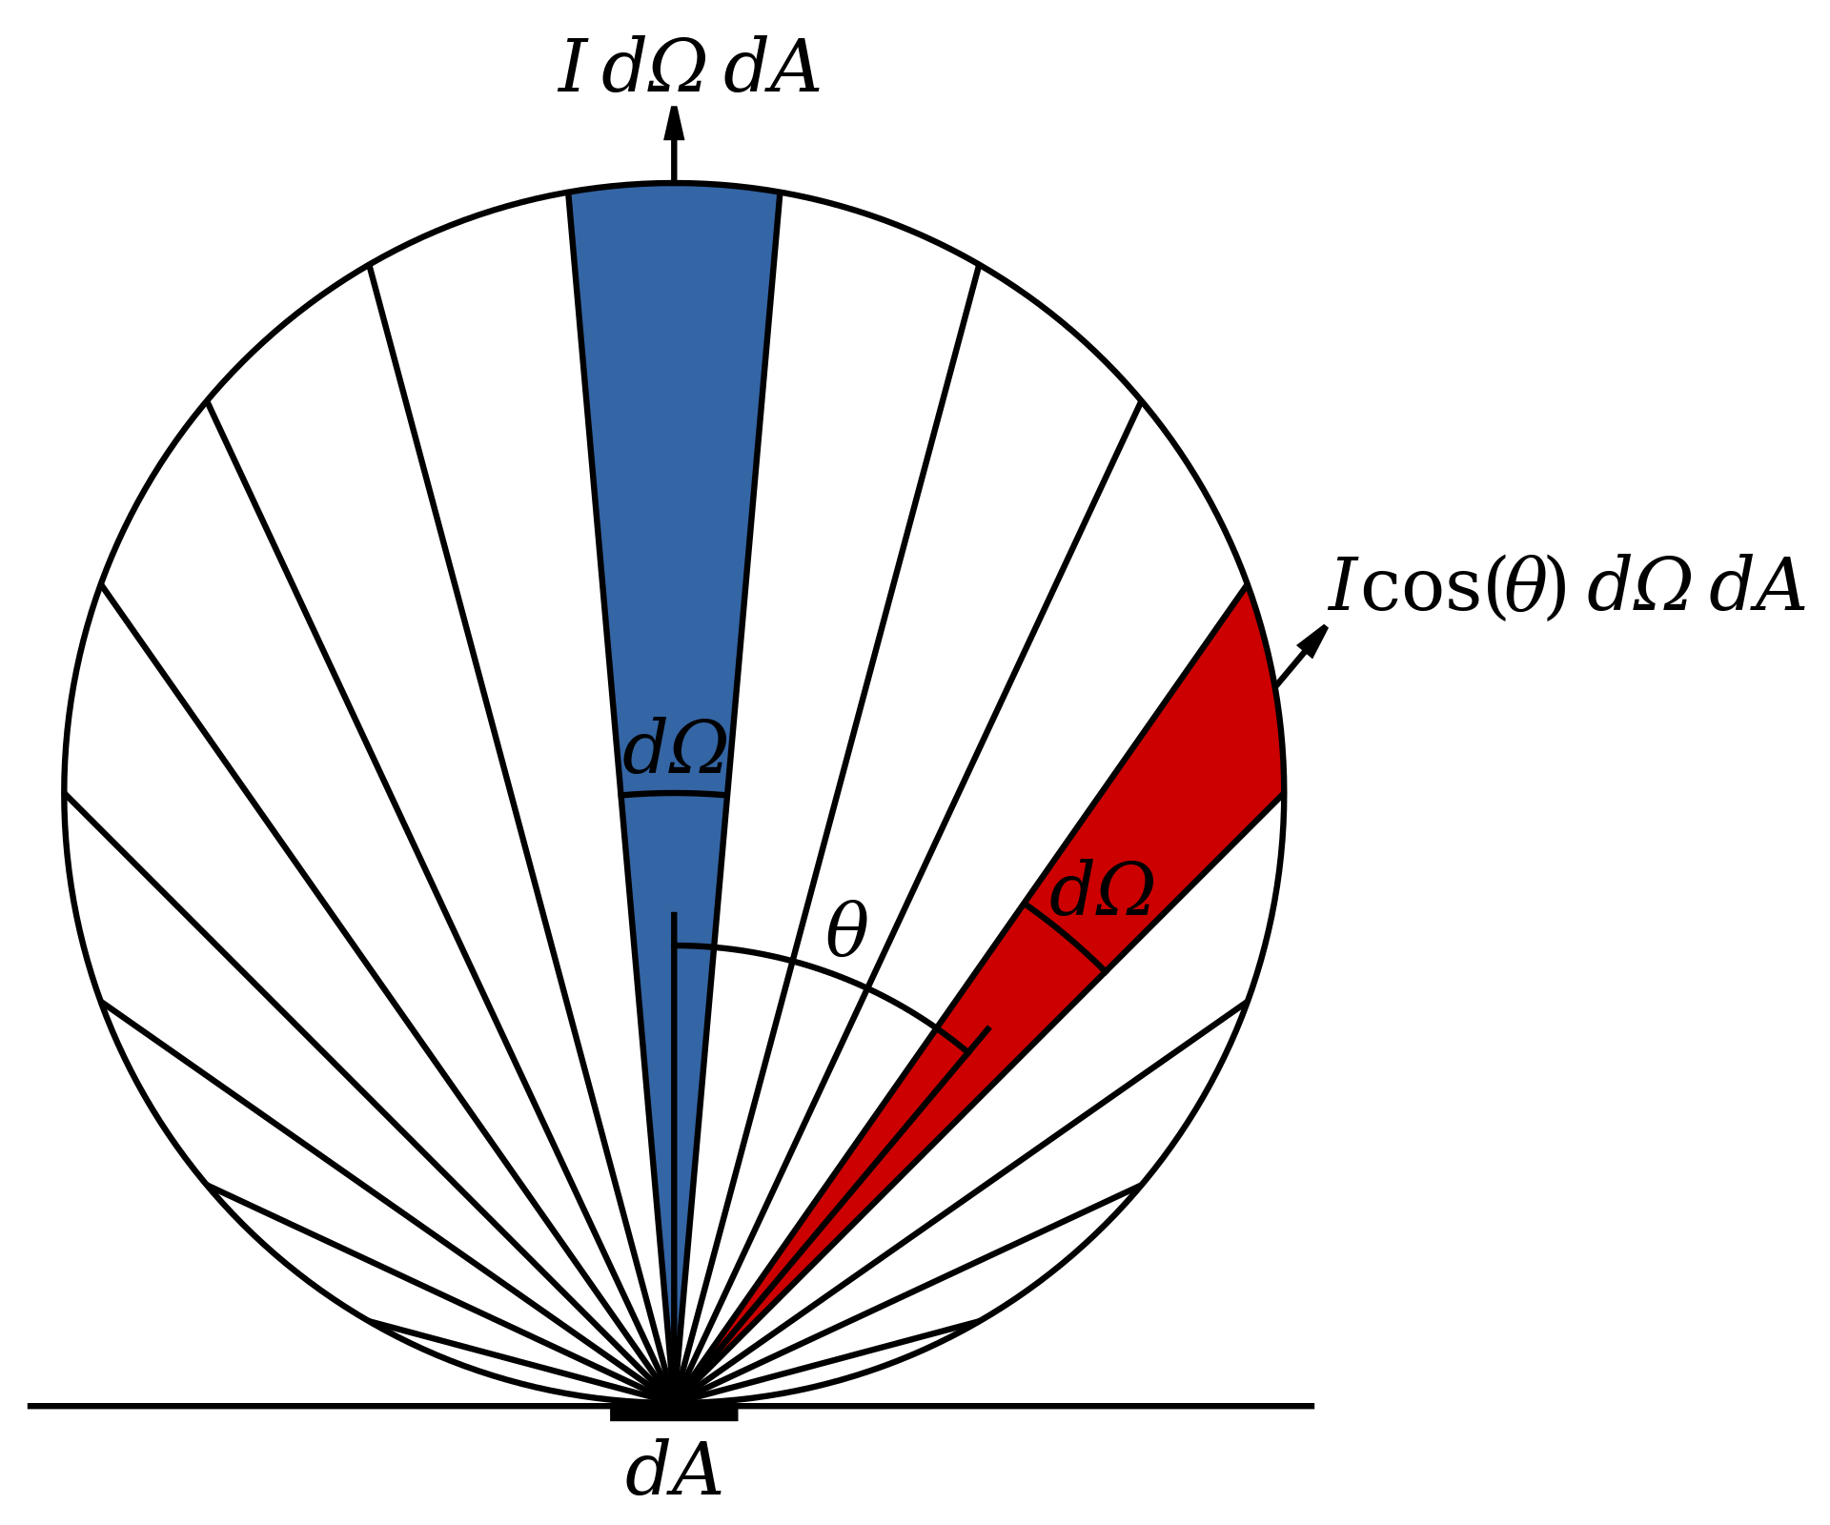
Theoretical descriptions of black body radiation
Source: https://en.wikipedia.org/wiki/Lambert%27s_cosine_law
Lambert‘s cosine law
Under the assumption that radiation is emitted isotropic, the measured power at a detector is only dependent of their relative position, i.e. the angle $θ$ between detector and emitting surface:
$$J\left(θ\right)=J⋅cos⁡(θ)$$
[1]: Univ.-Prof. Dr. Gregor Weihs et. al., “Physics Laboratory 2, Experiment 10: Black body radiation.” Laboratory course manual, Summer semester 2023.

Slide 13
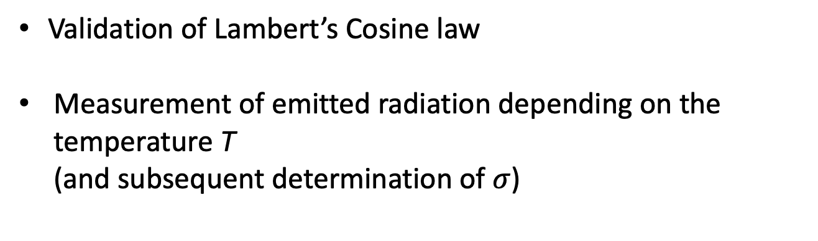
Objectives
Objectives:
Validation of Lambert’s Cosine law
Measurement of emitted radiation depending on the temperature T (and subsequent determination of $σ$)

Slide 14
Experimental setup

Slide 15
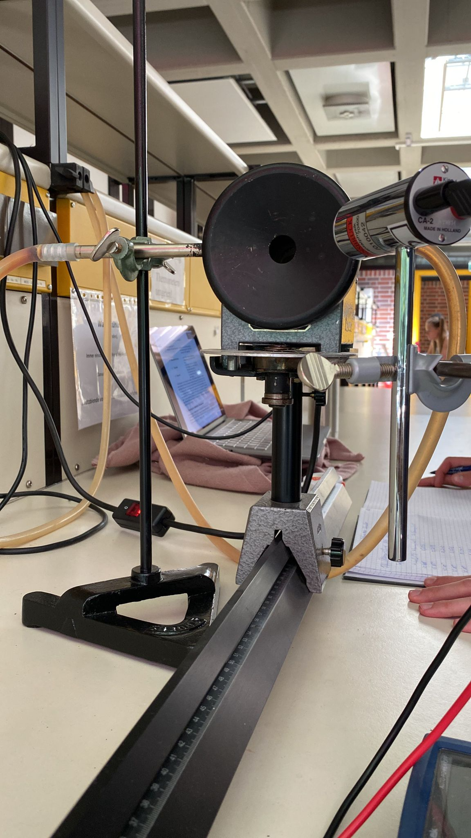
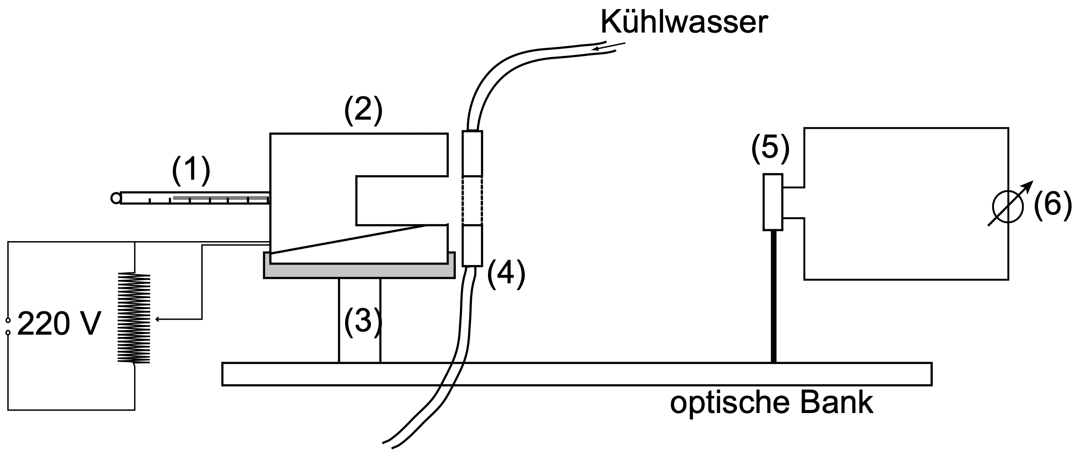
Experimental setup
protractor
1… thermometer
2… tube furnace (= black body)
3… small table
4… water cooled aperture
5… thermopile
6… measuring devide / multimeter
[1]: Univ.-Prof. Dr. Gregor Weihs et. al., “Physics Laboratory 2, Experiment 10: Black body radiation.” Laboratory course manual, Summer semester 2023.

Slide 16
Results and Discussion

